Slide 2


Slide 5
Notes:
and rest

Slide 6
rest
Notes:
Originally, the user had to wait, think ..

Slide 7

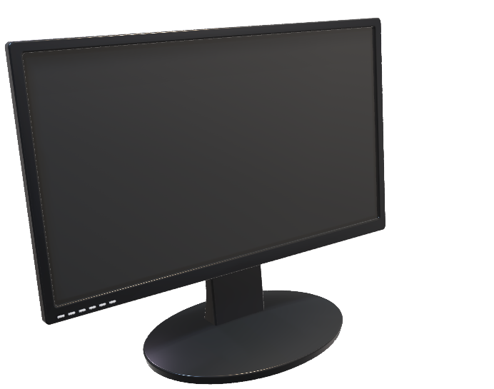
rest
Notes:
That is boring..

Slide 8

rest
Notes:
That is boring..

Slide 9
Notes:
That is boring..

Slide 10
Notes:
That is boring..

Slide 12


Slide 13


Slide 14


Slide 18



Slide 21


